Slide 1

Addressing Pediatric
Firearm Injury
Modifiable Slides for Use

Slide 2
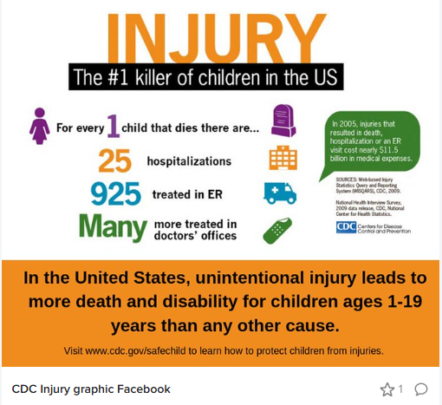

Slide 3


Slide 4
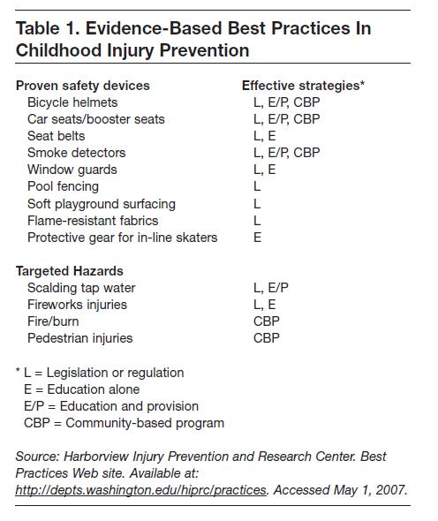
In practice injury prevention initiatives
Lead poisoning
Safe sleep
Sun Safety
Fluoride
Poisoning

Slide 5
Why not firearm safety initiatives?
Political Polarization
Divided views
Lack of consensus
Limited research
Limited funding
Lack of consensus on where to focus efforts

Slide 6
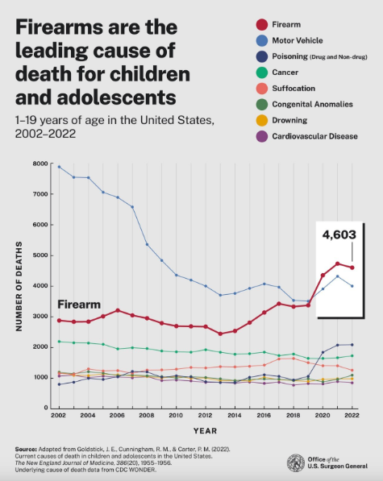
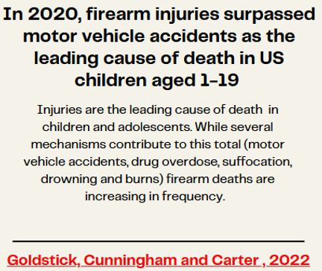
The Problem

Slide 7
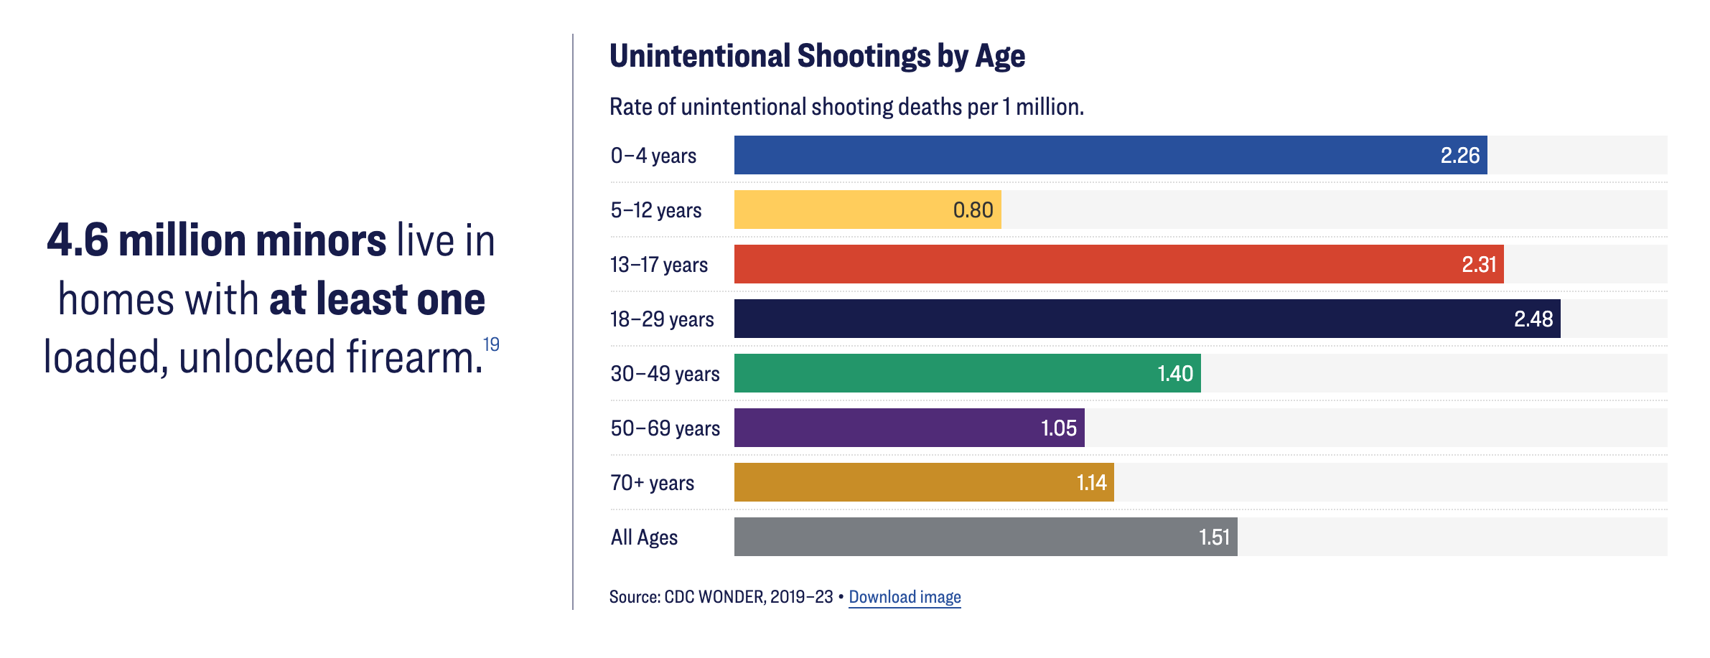
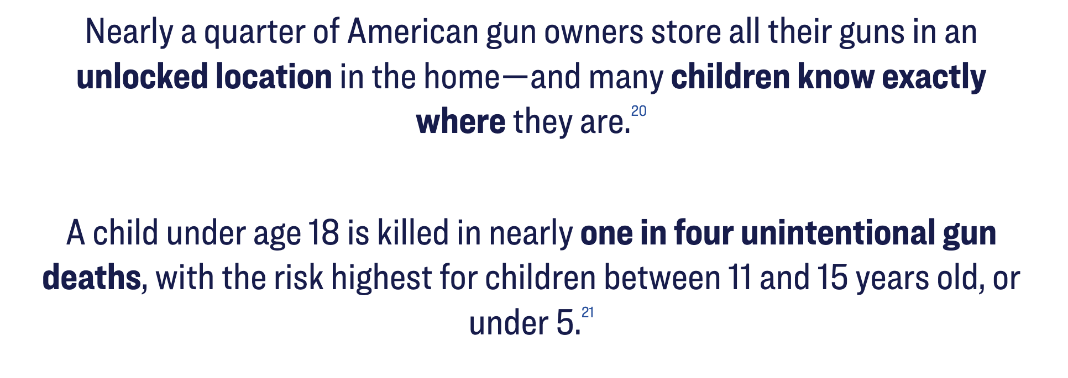

Slide 8
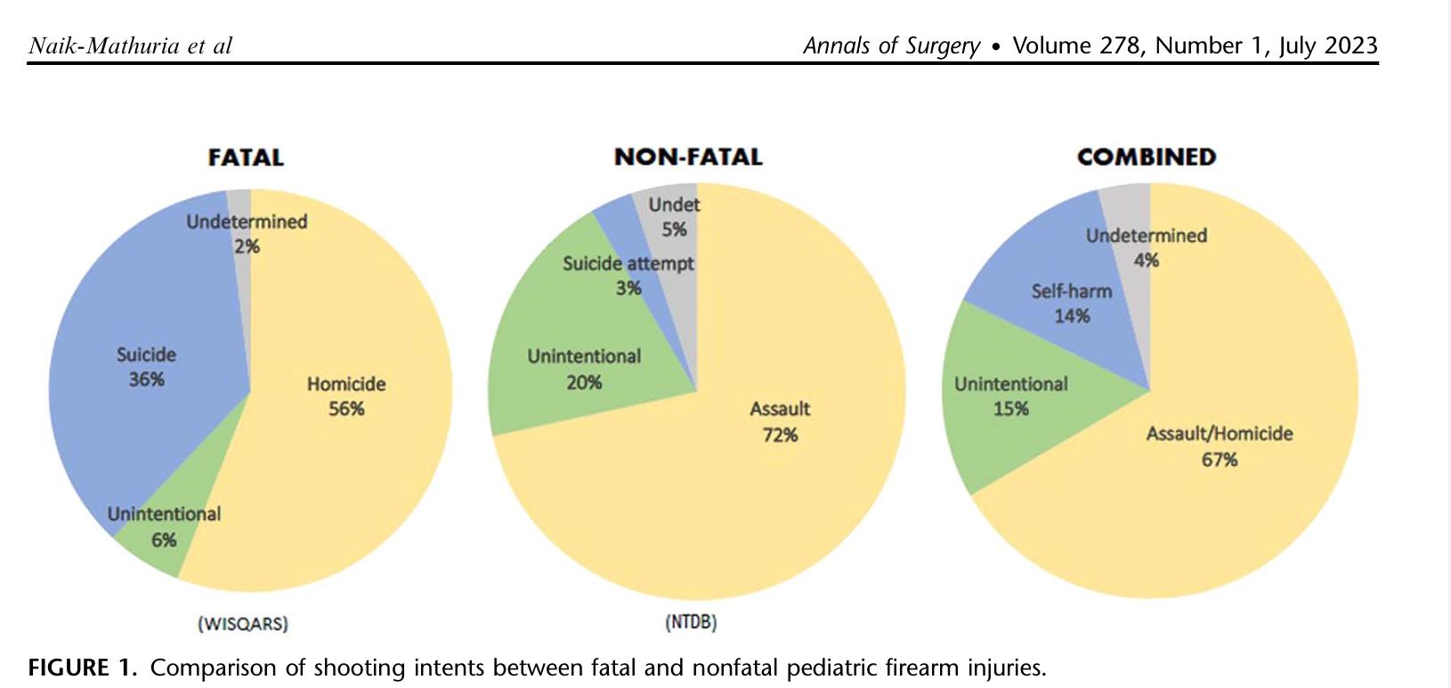
The Possible Causes

Slide 9
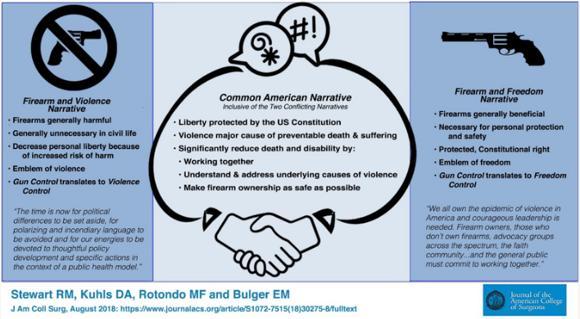
Common American Narrative Solutions

Slide 10
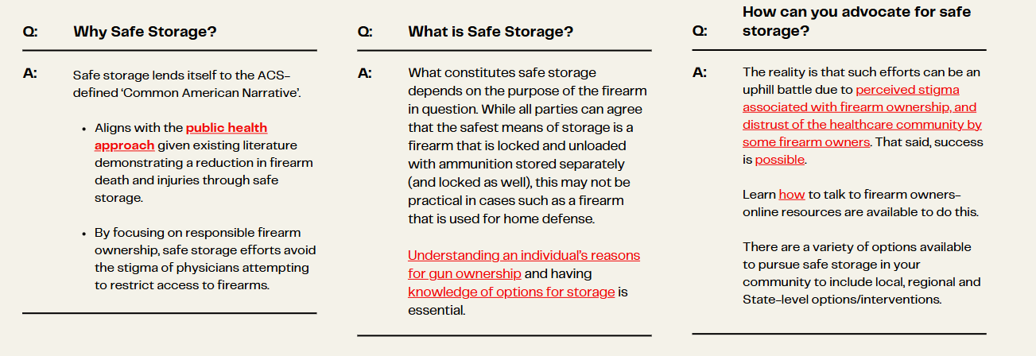
Safe Storage

Slide 11


Slide 12
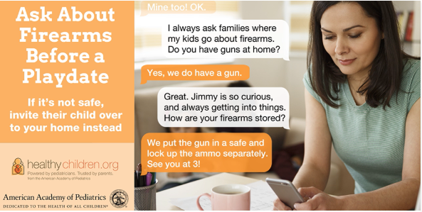

Slide 13




Safe Gun Storage Saves Lives
Keep your Loved Ones Safe: Store Firearms Securely
Lock it up: Use a gun safe, lockbox, or trigger lock
Keep it away from kids: Children are curious – store firearms unloaded and out of reach
Separate ammo: Store ammunition in a different locked location
Talk about it: Make sure everyone in your home knows the rules
Protect your family. Prevent accidents. Secure your firearm.
Notes:
Chat GPT to create flier for safe gun storage

Slide 14
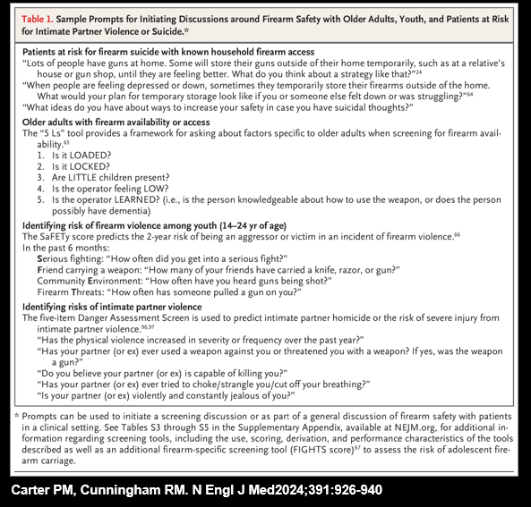
Initiate Conversations about Firearm Safety With Your Patients

Slide 15
Utilize resources to start the conversation
Fliers (AAP) in your office / exam rooms
Work safe storage into your history and examination
Provide families with a resource – easy access
Engage in traumatic situations
Open the conversation – don’t pressure
Small efforts slowly lead to change

Slide 16
Local engagement – Utilize help
Enlist trauma programs to provide additional support and guidance
Most have required preventative safety initiatives
Can combine resources to reach patients and families in the acute hospital setting
Case management
Local community leaders: engage and provide support to their local families

Slide 17
Lockbox Initiatives
Trauma center and preventative safety grants
Buy lockboxes to provide to families at hospital
Education on safe storage to families
Some gun owners do not have just handguns
  Consider alternatives to a lockbox to provide safe storage for larger guns
Stress importance of storing gun and ammunition in separate locked areas

Slide 18

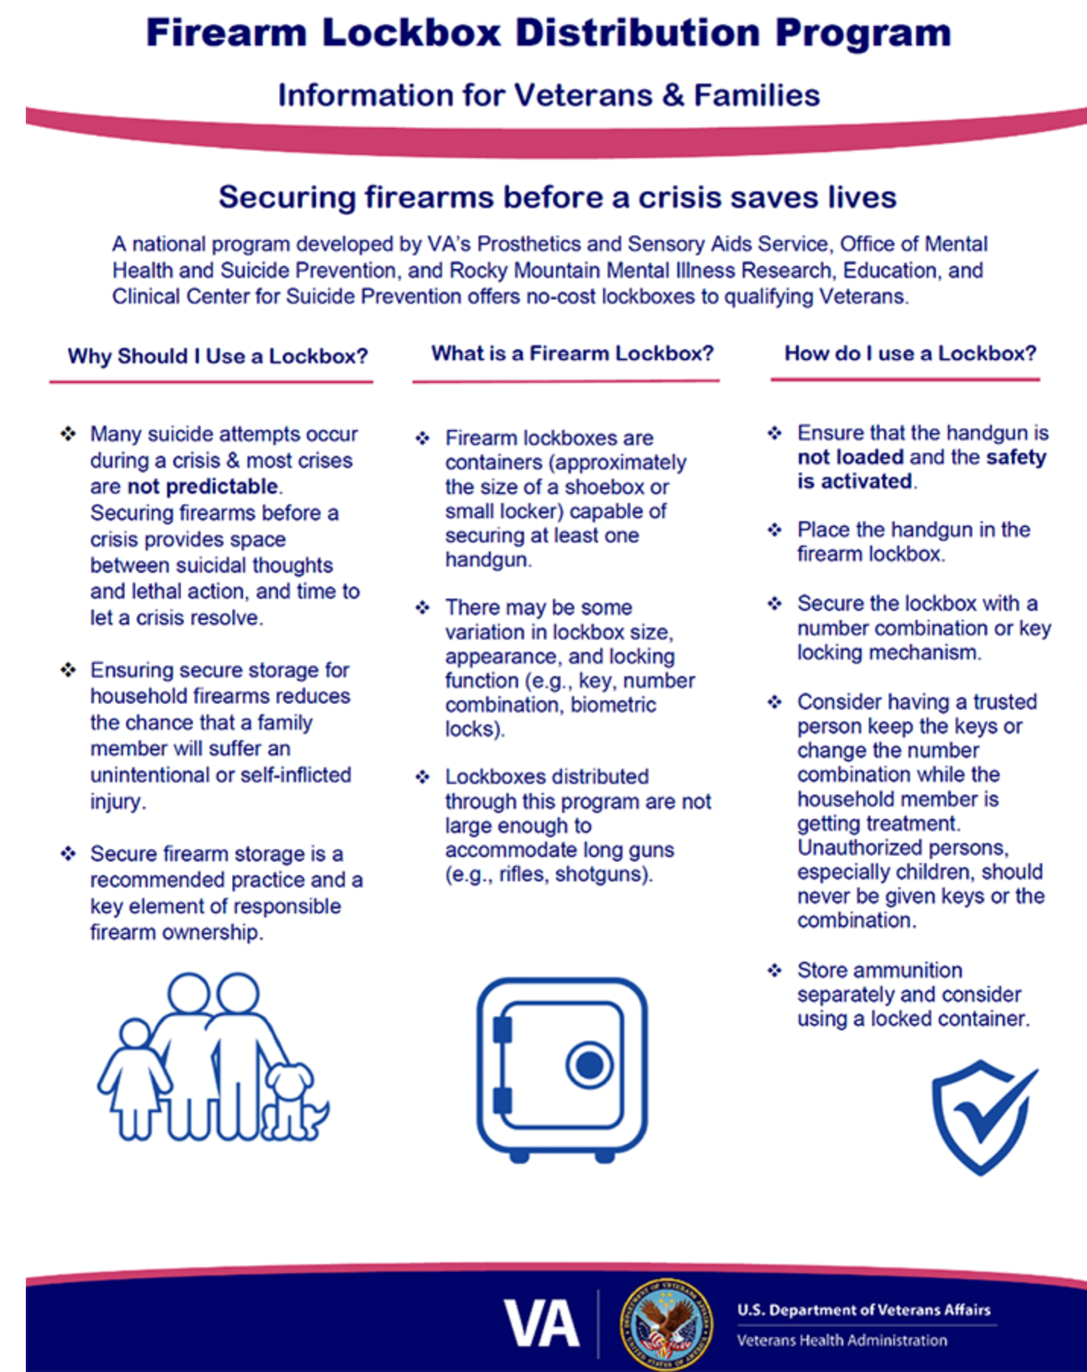
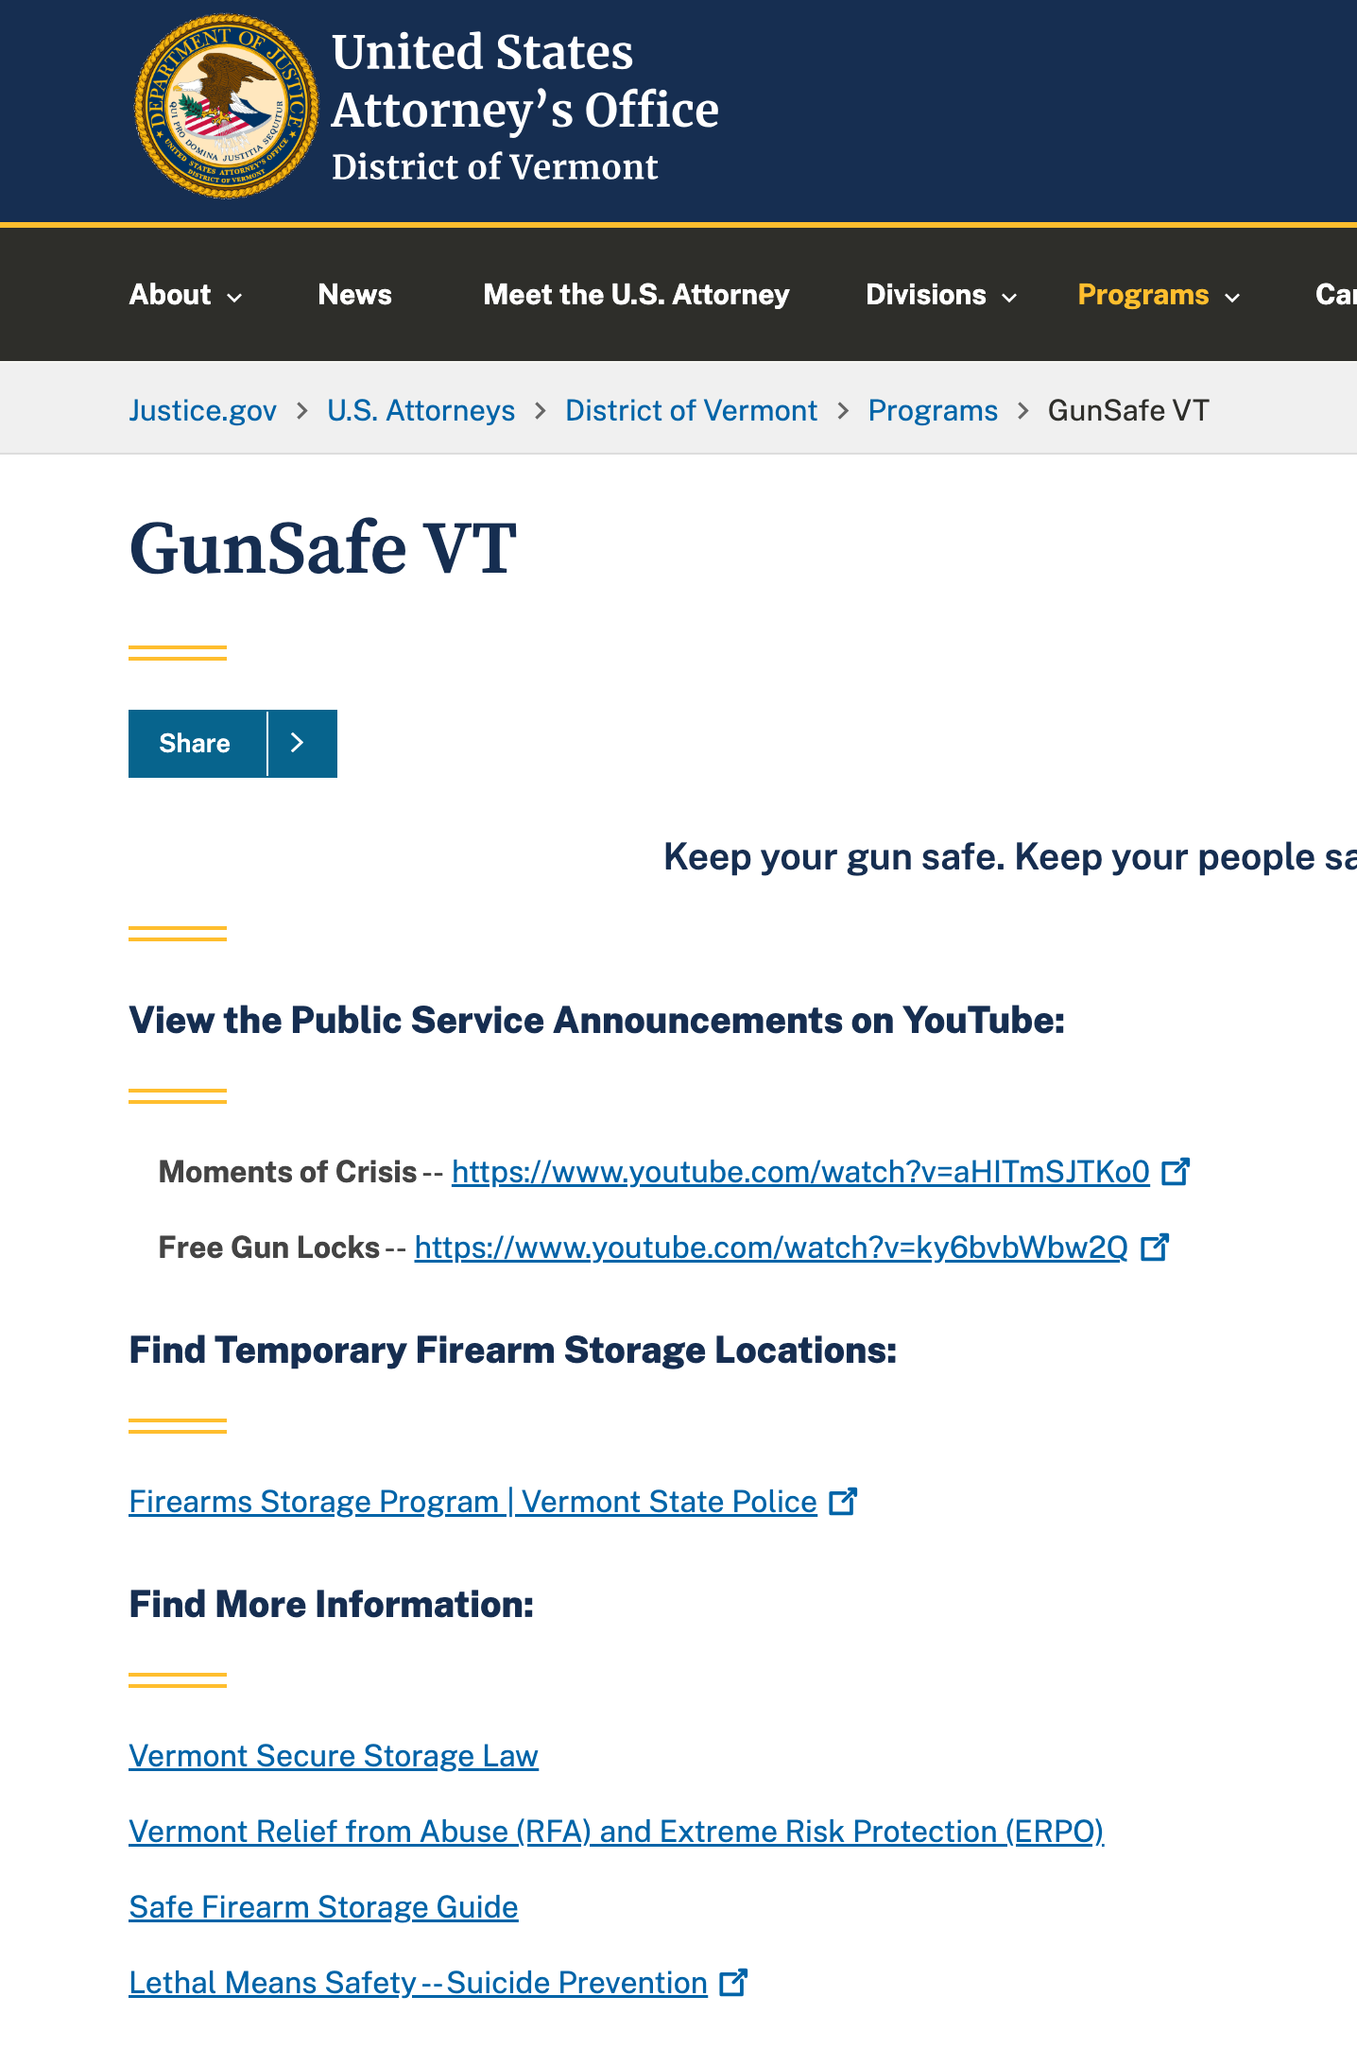

Notes:
Grants and other organizations focusing on safe gun storage

Slide 19
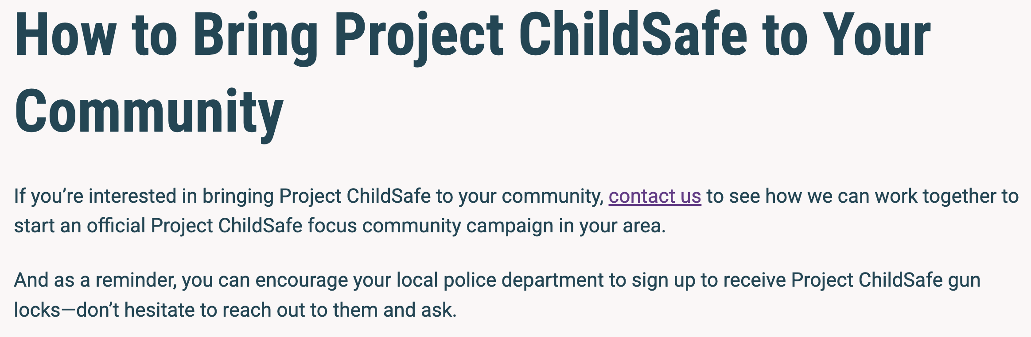
Safe Storage and Your State
Know current legislation on safe storage
Engage with your local officials to promote safe storage laws
  Dept. of Health resources
Utilize existing organizations to promote safe storage
  Project ChildSafe

Slide 20
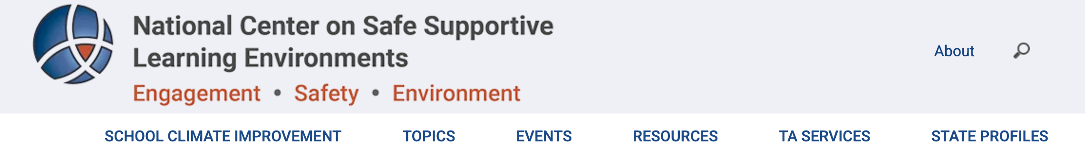
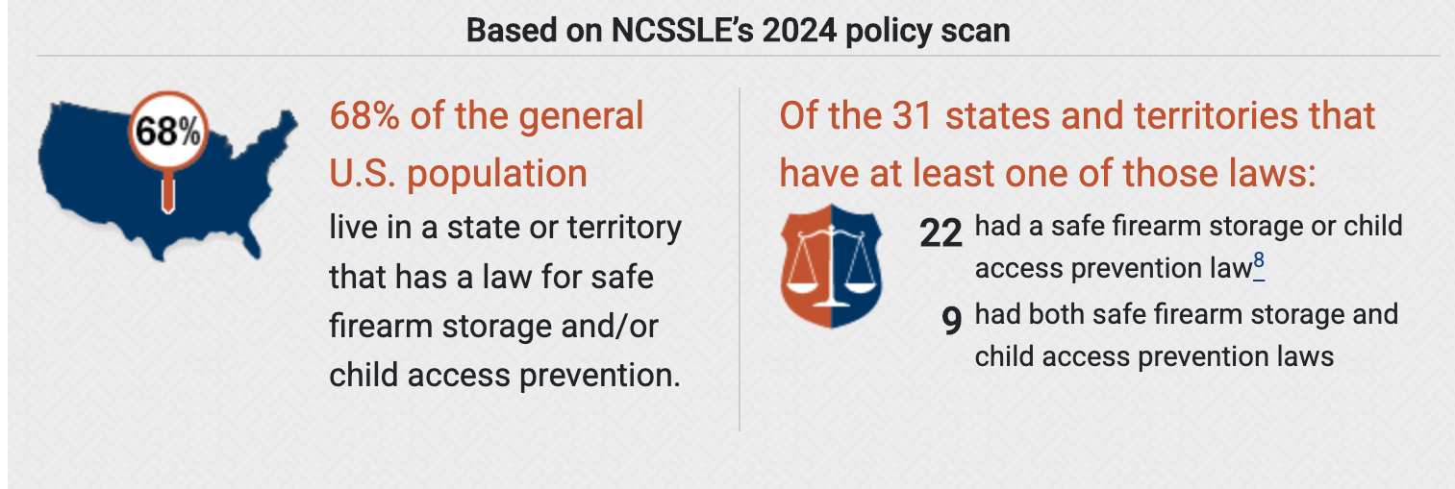

Slide 21
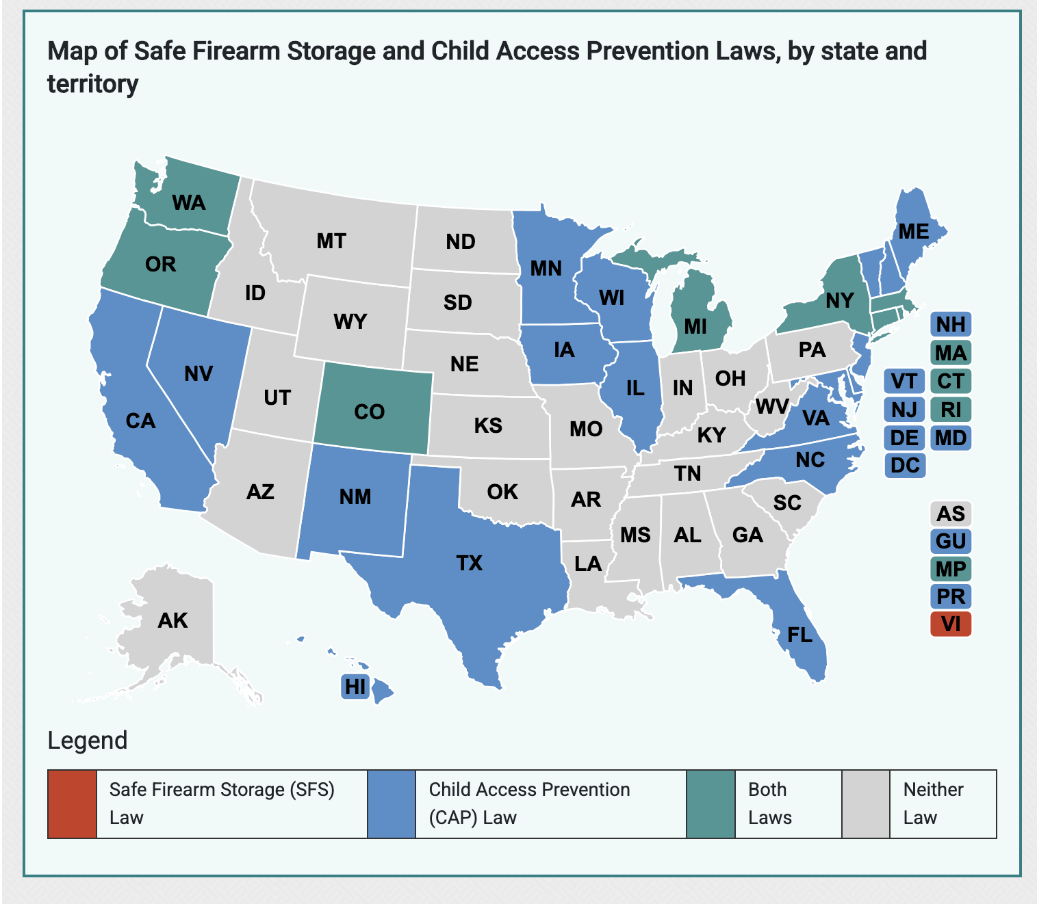
Your State and Firearm Storage Laws

Slide 22
**Edit for your state*
Expanding Efforts
Engagement with local and state officials
  KNOW YOUR LEGISLATORS
  Find My Legislators - Louisiana State Legislature ****edit to your state link
Educate on current statistics
  Gun ownership is personal – not trying to remove right to arms
  Stress safe storage and education
Participate in local and state medical societies
  LSMS – supports safe storage legislation, do not sell list, physician education on firearm injuries/deaths
Be prepared to testify
Notes:
Copy and paste URL for your state to find your legislators
Alabama: My Alabama Elected Officials
Alaska: Alaska State Legislature
Arizona: AZ IRC Official Legislative Map
Arkansas: Legislators - Arkansas State Legislature
California: Find Your California Representatives
Colorado: Find My Legislator | Colorado General Assembly
Connecticut: C G A - Connecticut General Assembly
Delaware: https://legis.delaware.gov/
Florida: Find Your Legislators - The Florida Senate
Georgia: Georgia General Assembly - Find Your Legislator
Hawaii: Find Your Legislator
Idaho: Who’s My Legislator? – Idaho State Legislature
Illinois: Find My Elected Officials
Indiana: IGA | Find Your Legislator
Iowa: Iowa Legislature - Find Your Legislator
Kansas: Welcome | Kansas State Legislature
Kentucky: Find Your Legislator
Louisiana: Find My Legislators - Louisiana State Legislature
Maine: Maine House of Representatives
Maryland: Members - Find My Representatives
Massachusetts: Find My Legislator
Michigan: FindYourSenator
Minnesota: Minnesota Legislature
Mississippi: House - District Map | MISSISSIPPI LEGISLATURE
Missouri: Senator Missouri Senate | Missouri Senate
Montana: Legislator Explorer
Nebraska: Nebraska Legislature - Home
Nevada: Who's My Legislator / What's My District
New Hampshire: The New Hampshire House of Representatives
New Jersey: NJ Legislature
New Mexico: Find My Legislator - New Mexico Legislature
New York: Assembly Member Search | New York State Assembly
North Carolina: Representation - North Carolina General Assembly
North Dakota: https://ndlegis.gov/faq#
Ohio: legislature.ohio.gov/
Oklahoma: https://www.oklegislature.gov/
Oregon: https://geo.maps.arcgis.com/apps/instant/lookup/index.html?appid=fd070b56c975456ea2a25f7e3f4289d1
Pennsylvania: https://www.palegis.us/
Rhode Island: https://vote.sos.ri.gov/Home/PollingPlaces?ActiveFlag=3
South Carolina: https://www.scstatehouse.gov/
South Dakota: https://sdlegislature.gov/Legislators/Find
Tennessee: https://wapp.capitol.tn.gov/Apps/fml2022/search.aspx
Texas: https://capitol.texas.gov/
Utah: https://le.utah.gov/GIS/findDistrict.jsp
Vermont: https://legislature.vermont.gov/
Virginia: https://whosmy.virginiageneralassembly.gov/
Washington: https://app.leg.wa.gov/districtfinder
West Virginia: https://joint.wvlegislature.gov/lawmaker-search/
Wisconsin: https://maps.legis.wisconsin.gov/
Wyoming: https://experience.arcgis.com/experience/f086f052f28b4185a785f19344a057be/

Slide 23
2025 State Laws Adopted
Search your state legislature to find bills related to gun safety
  Find your state in the comment section, copy and paste URL
  Search “gun” and/or “firearm safety” or “firearm storage”
  Often under public safety legislation
Following slides as examples
  Each state legislature is slightly different
  Can see status of bill
    In Committee, Passed, Failed
    Legislators responsible: good contacts to engage in conversations for gun safety
Notes:
Copy and paste URL for your state to search bills:
Alabama: https://www.legislature.state.al.us/legacy/Splash_Bills.aspx
Alaska: https://www.akleg.gov/basis/Home/BillsandLaws
Arizona: https://www.azleg.gov/bills/
Arkansas: https://arkleg.state.ar.us/Bills/Search
California: https://leginfo.legislature.ca.gov/faces/billSearchClient.xhtml
Colorado: https://leg.colorado.gov/bills
Connetticut: https://www.cga.ct.gov/#
Delaware: https://legis.delaware.gov/AllLegislation
Florida: http://www.leg.state.fl.us/Welcome/index.cfm
Georgia: https://www.legis.ga.gov/search
Hawaii: https://www.capitol.hawaii.gov/account/
Idaho: https://lso.legislature.idaho.gov/MyBillTracker/Login_input.do
Illinois: https://www.ilga.gov/Legislation
Indiana: https://iga.in.gov/search
Iowa: https://www.legis.iowa.gov/
Kansas: https://kslegislature.gov/li/b2025_26/measures/bills/
Kentucky: https://apps.legislature.ky.gov/record/25rs/record.html
Louisiana: https://www.legis.la.gov/legis/BillSearch.aspx?sid=last
Maine: https://legislature.maine.gov/mrs-search/billtext.html
Maryland: https://mgaleg.maryland.gov/mgawebsite/Search/Legislation
Massachusetts: https://malegislature.gov/Bills/Search
Michigan: https://legislature.mi.gov/Bills
Minnesota: https://www.leg.mn.gov/leg/legis
Mississippi: https://www.legislature.ms.gov/legislation/text-search/
Missouri: https://house.mo.gov/billcentral.aspx
Montana: https://bills.legmt.gov/
Nebraska: https://nebraskalegislature.gov/bills/
Nevada: http://search.leg.state.nv.us/83rd2025/Bills/83rd2025_Bills.html
New Hampshire: https://gc.nh.gov/bill_Status/advanced.aspx
New Jersey: https://njleg.state.nj.us/#billSearch
New Mexico: https://www.nmlegis.gov/Legislation/Bill_Finder
New York: https://nyassembly.gov/leg/?sh=advanced
North Carolina: https://www.ncleg.gov/Search/BillText
North Dakota: https://ndlegis.gov/assembly/69-2025/bill-index.html?
Ohio: https://www.legislature.ohio.gov/legislation/search?start=1&pageSize=25&sort=Number&generalAssembly=135
Oklahoma: https://www.oklegislature.gov/AdvancedSearchForm.aspx
Oregon: https://www.oregonlegislature.gov/citizen_engagement/Pages/Find-a-Bill.aspx
Pennsylvania: https://www.palegis.us/legislation/bills
Rhode Island: https://webserver.rilegislature.gov/BillText25/
South Carolina: https://www.scstatehouse.gov/subjectsearch.php
South Dakota: https://sdlegislature.gov/Session/Bills/70
Tennessee: https://wapp.capitol.tn.gov/apps/billsearch/BillSearchAdvanced.aspx
Texas: https://capitol.texas.gov/BillLookup/BillNumber.aspx
Utah: https://le.utah.gov/bills/bills_By_Session.jsp
Vermont: https://legislature.vermont.gov/bill/search/2026
Virginia: https://lis.virginia.gov/bill-search
Washington: https://app.leg.wa.gov/bi/topicalindex
West Virginia: https://www.wvlegislature.gov/Bill_Status/Bills_Subjects.cfm?year=2025&sessiontype=rs&btype=bill
Wisconsin: https://docs.legis.wisconsin.gov/2025
Wyoming: https://www.wyoleg.gov/Legislation/search

Slide 24
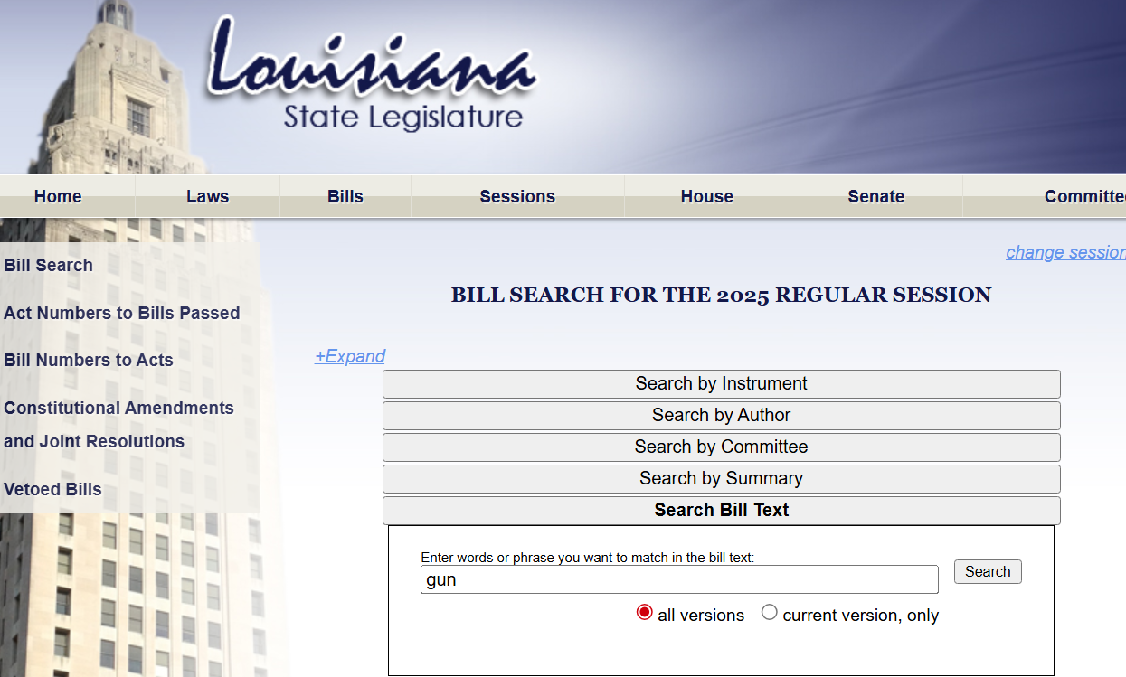
Bill Search - Louisiana State Legislature

Slide 25
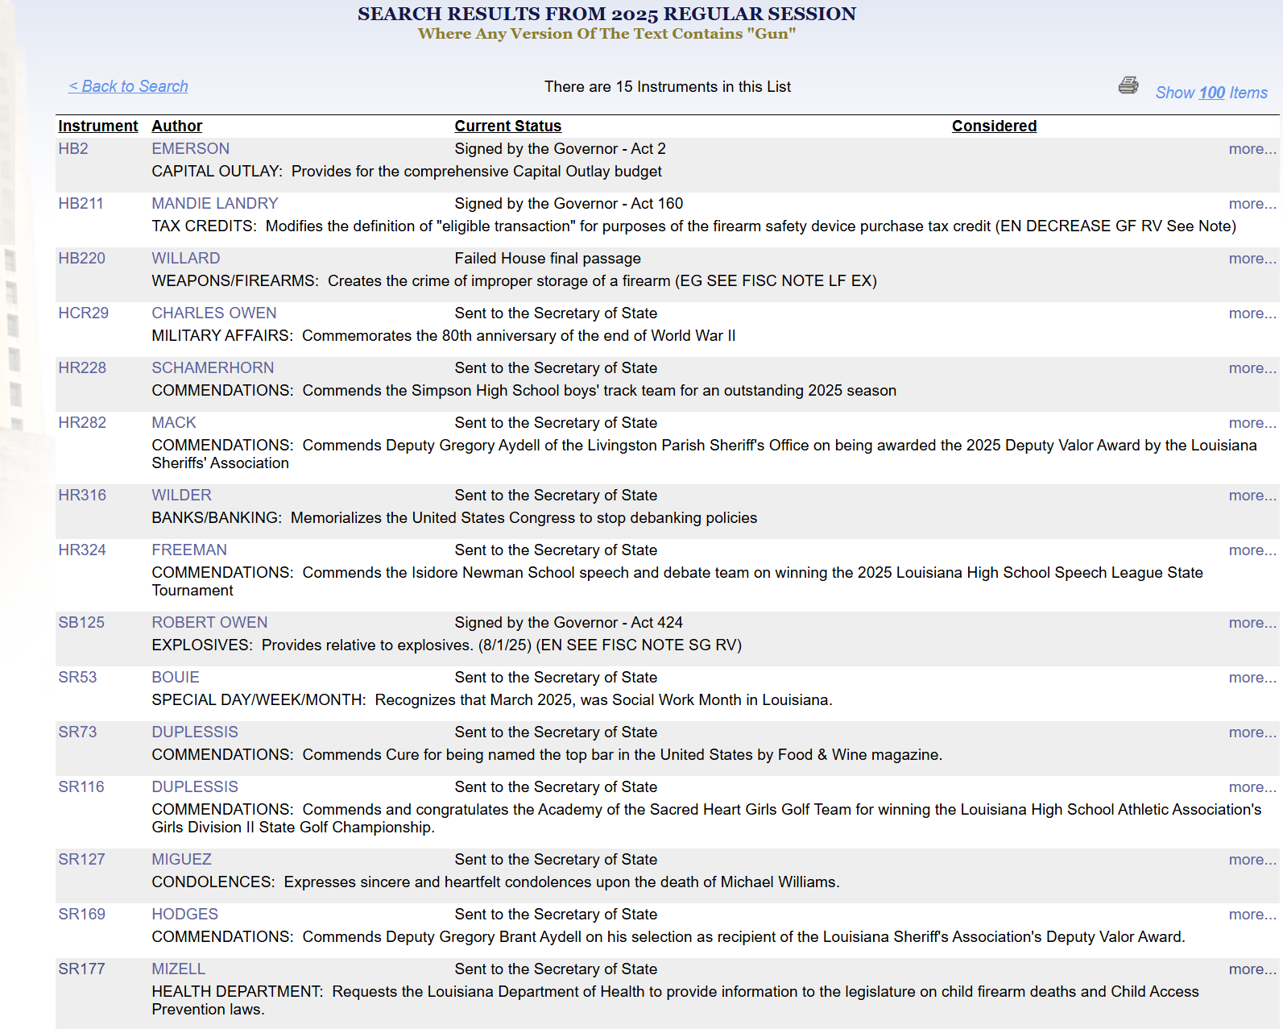
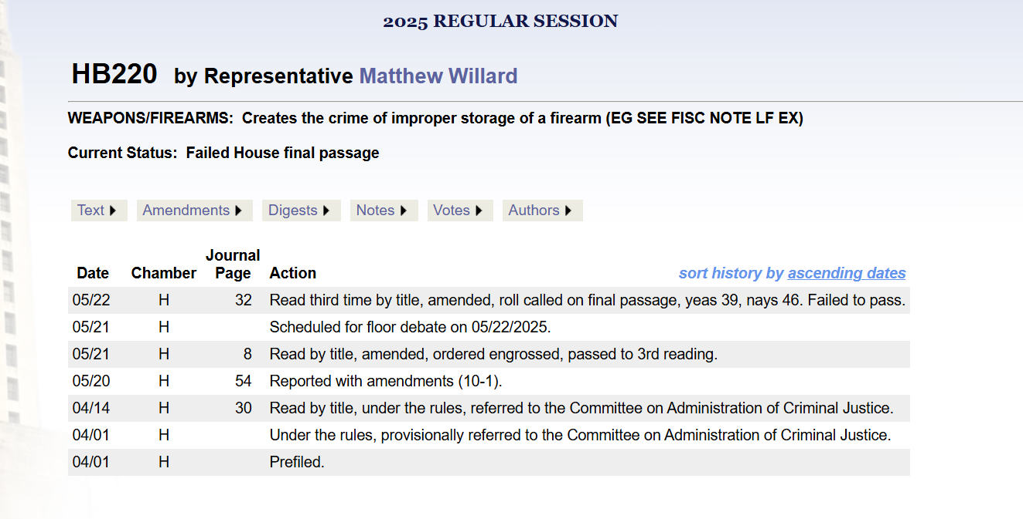
Search your state legislature to find bills related to gun safety
  Louisiana 2025 Legislature “bill search”
  Search: “gun”

Slide 26
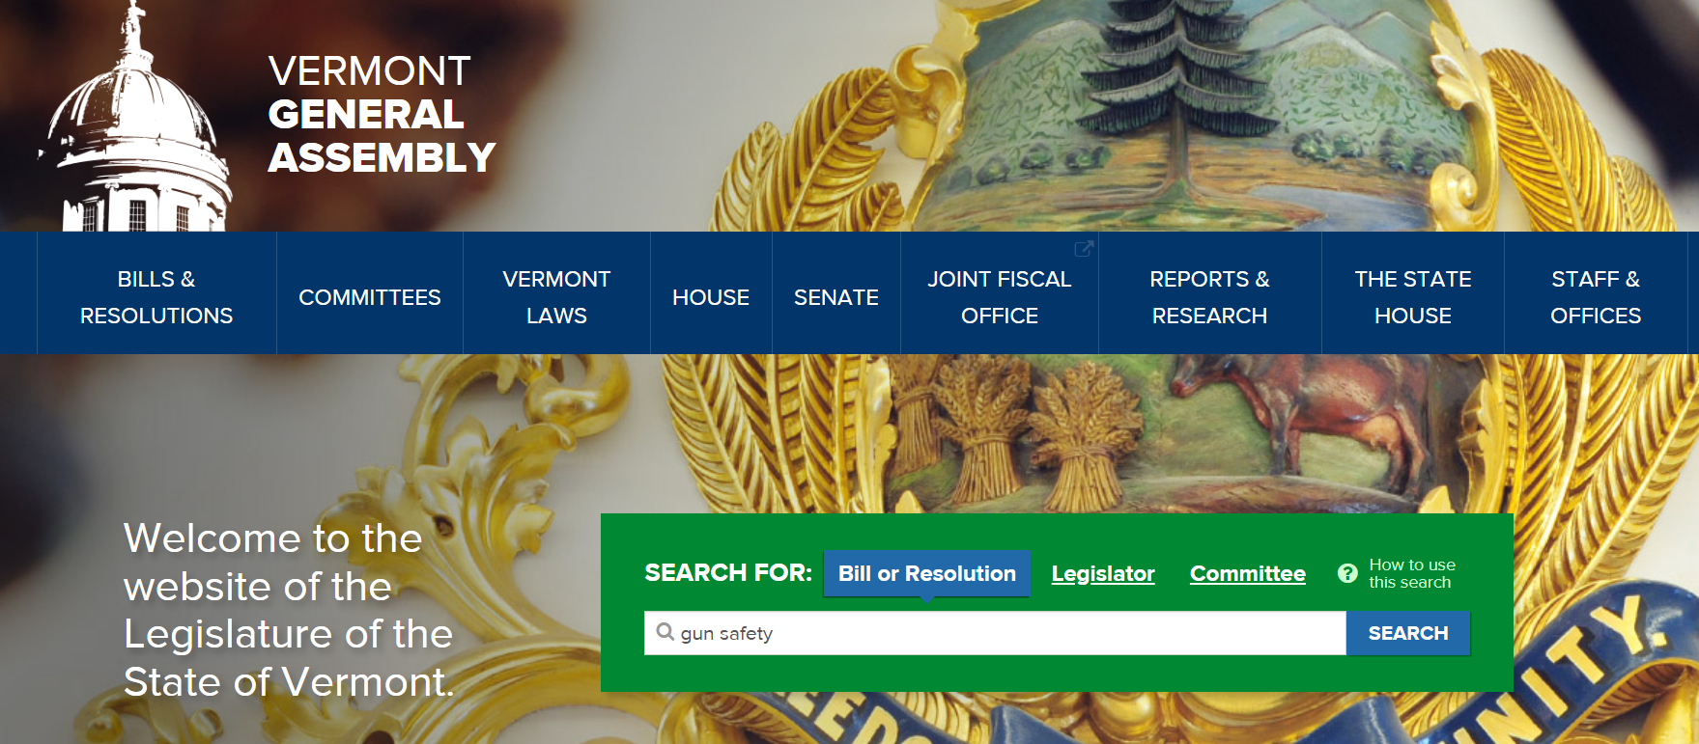
Home | Vermont General Assembly | Vermont Legislature

Slide 27
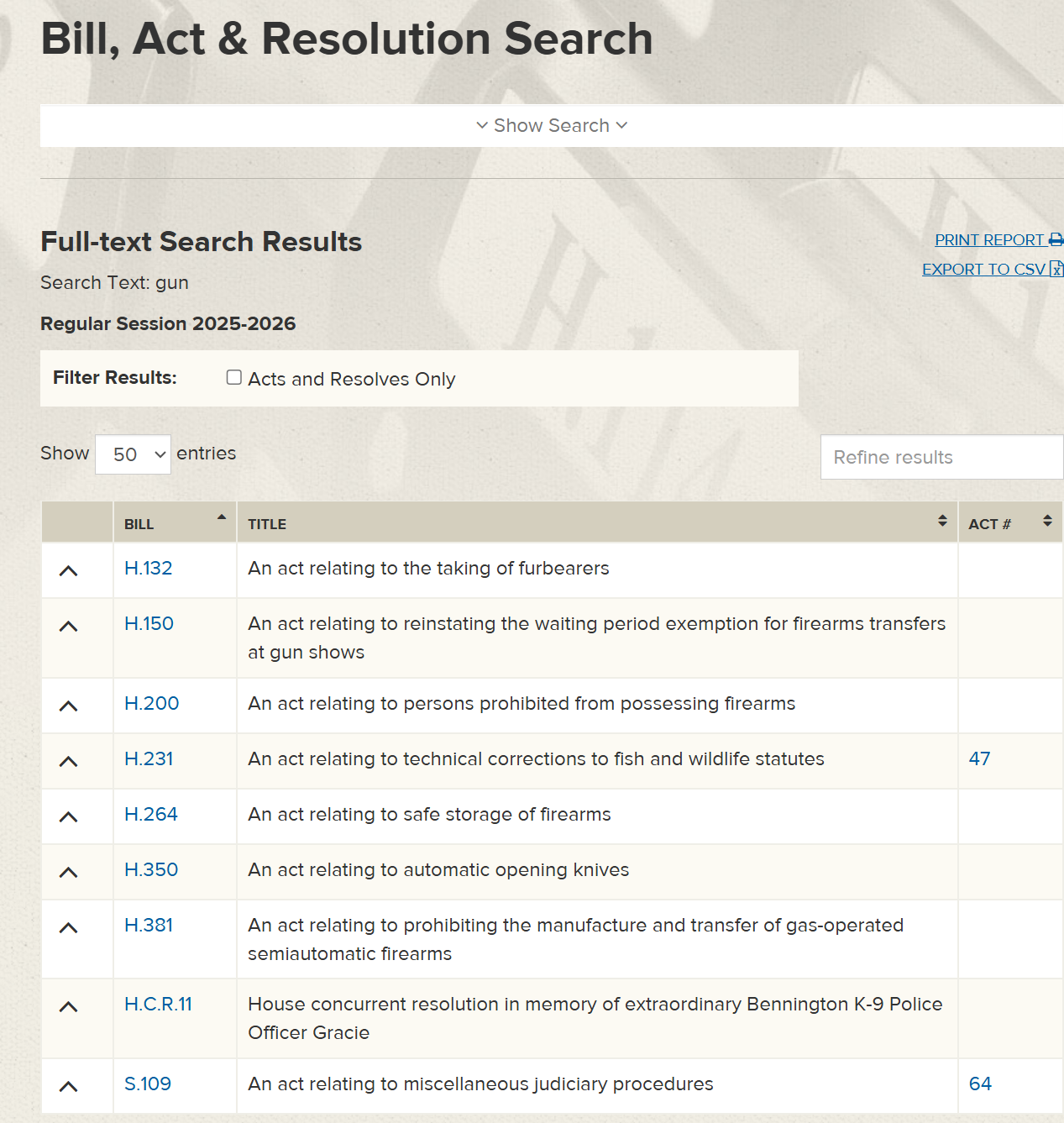
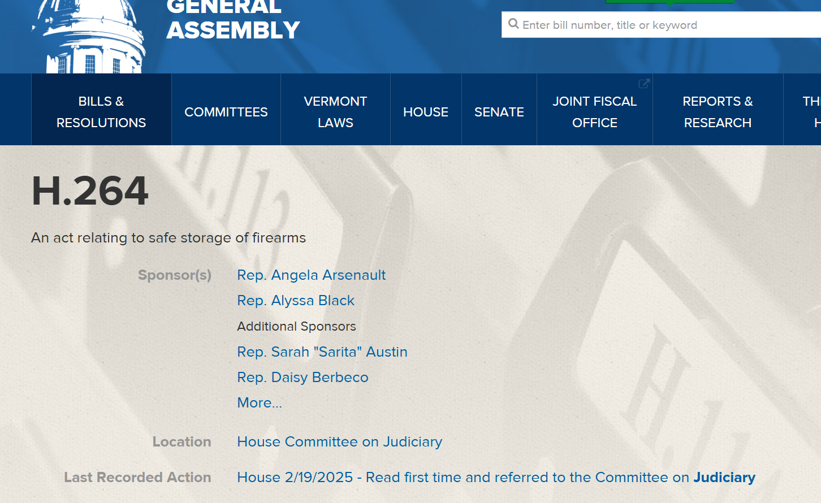
Search your state legislature to find bills related to gun safety
  Vermont Legislature “bill search”
  Search: “gun”

Slide 28
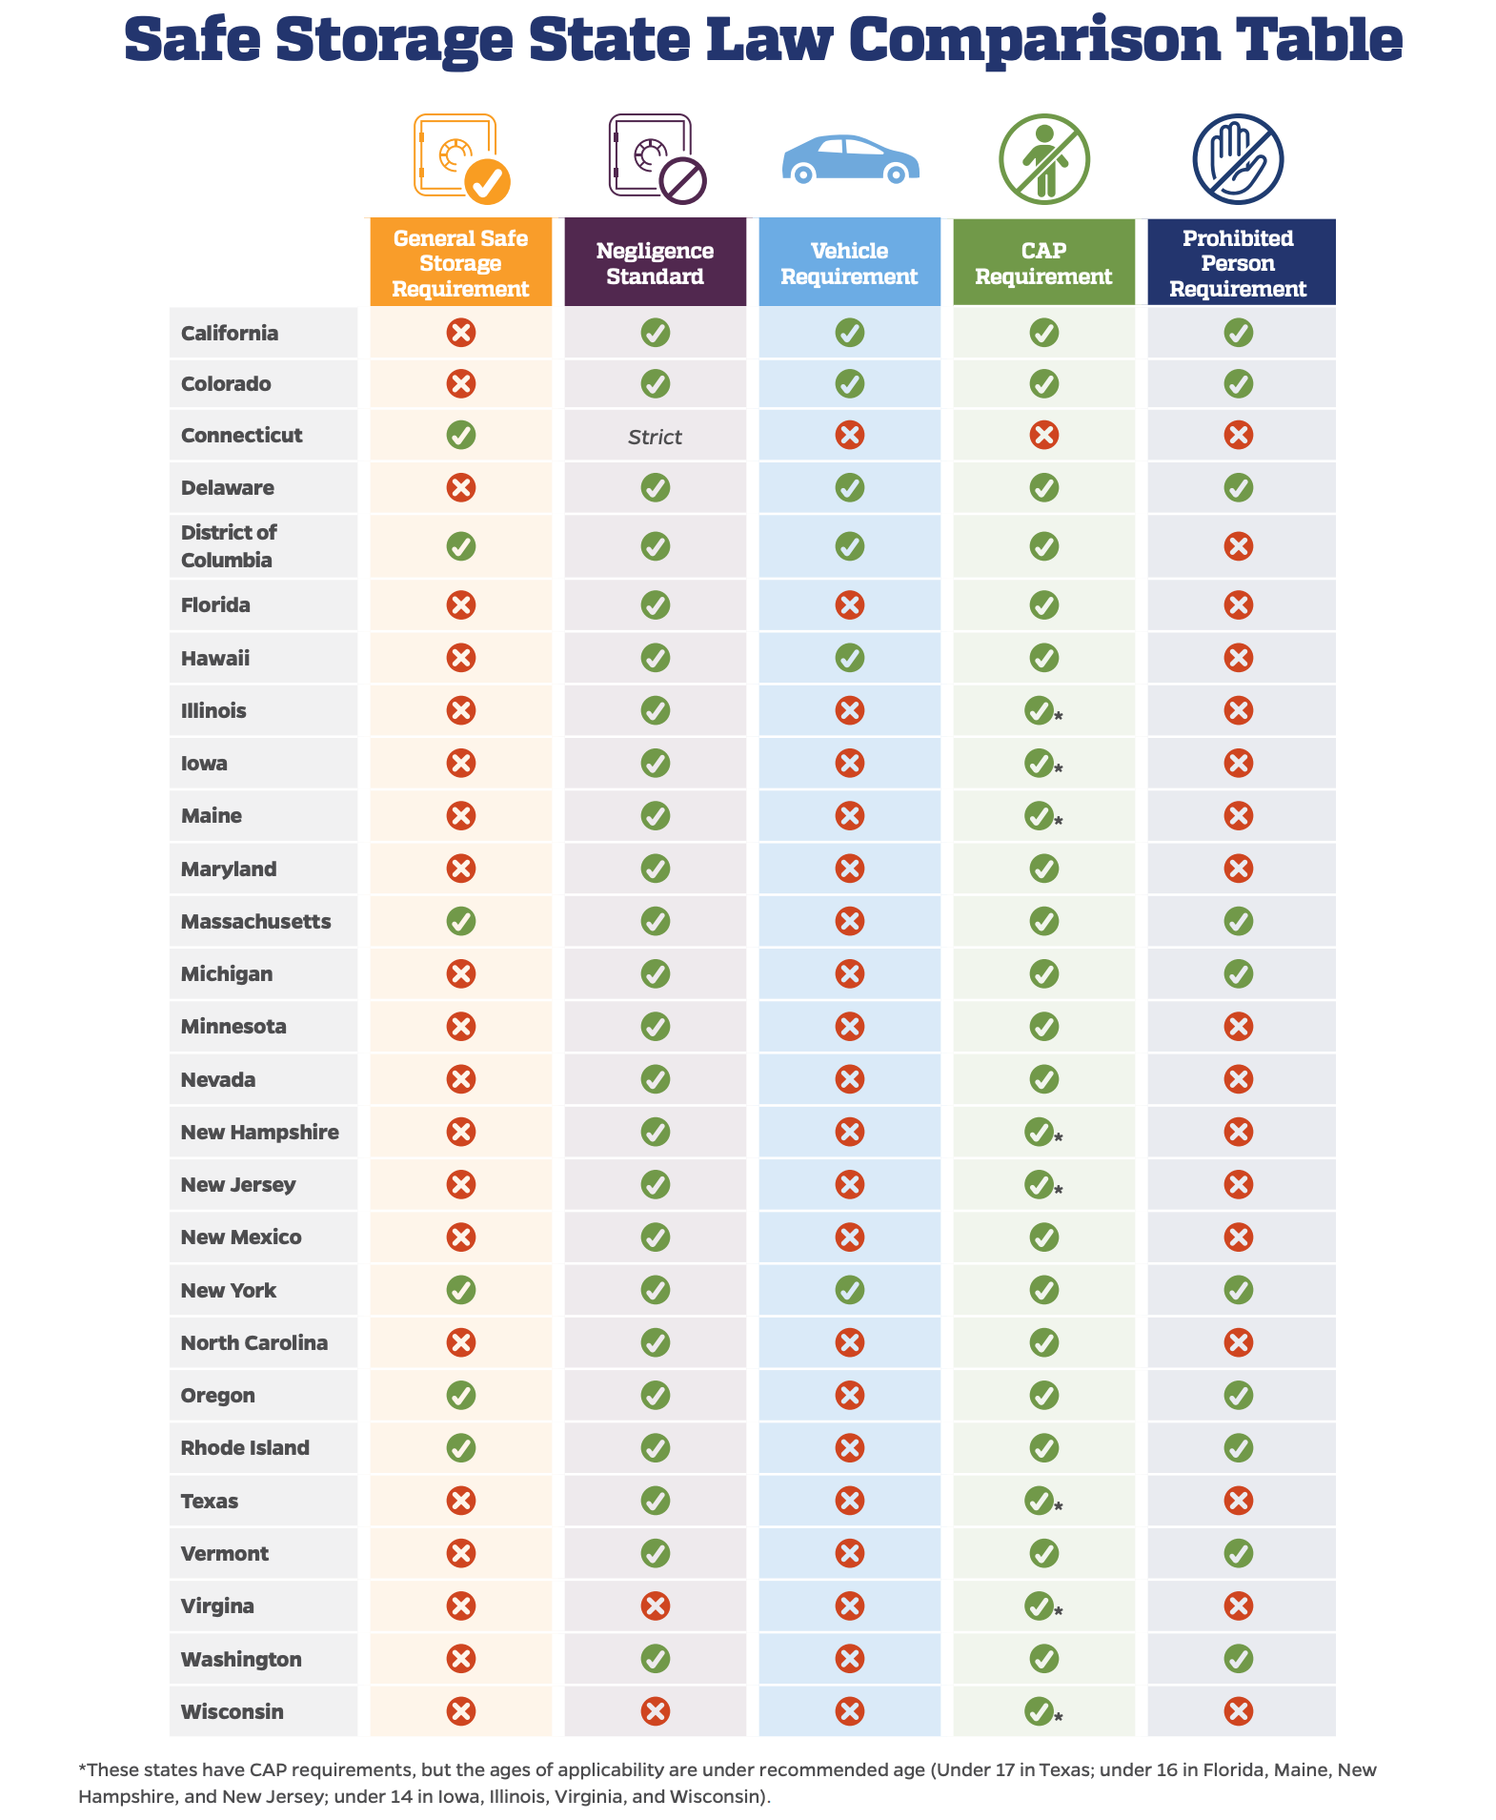
SB 0008 - Improving Safe Gun Storage Requirements
The Safe Gun Storage Act, co-sponsored by Sen. Laura Ellman and Rep. Maura Hirschauer, strengthens Illinois’ firearm storage law to further prevent access to firearms for children, at-risk individuals, and individuals prohibited from firearm use.
"The legislation we celebrate today is not about taking things away from people – it's about mandating simple protections that will save lives. Because too often guns end up in the hands of those who can't understand the power of the object they hold," said Illinois Lt. Governor Juliana Stratton.

Slide 29

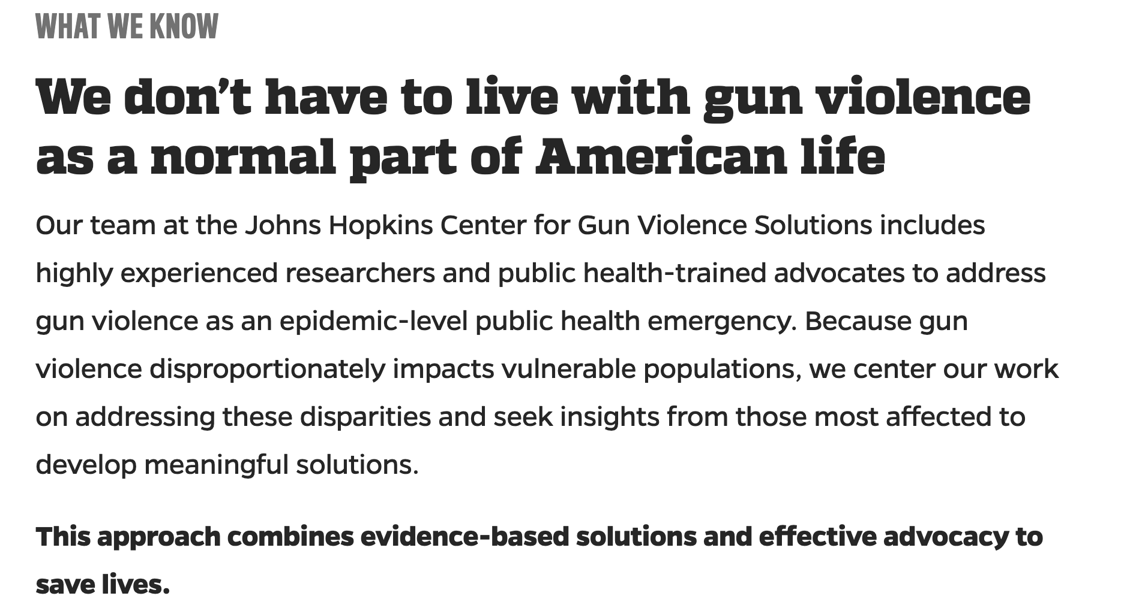

Local opportunities: Higher education engagement
Many universities recognize firearm injury prevention as a public health initiative

Slide 30

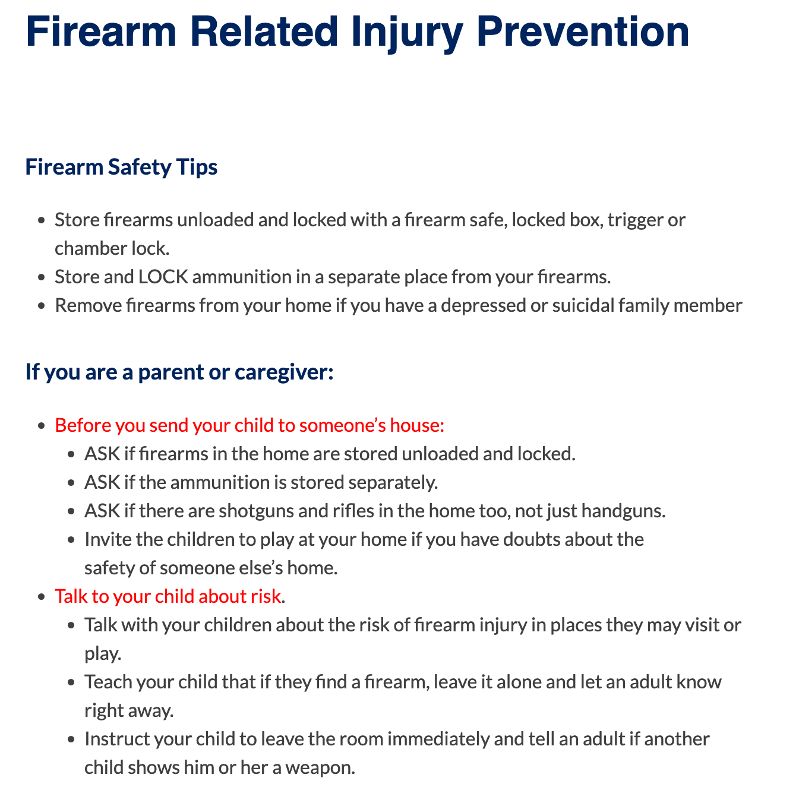
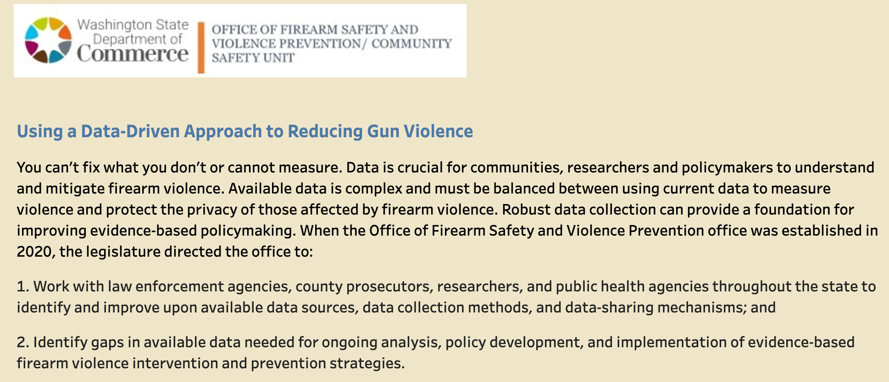
Local opportunities: State dept. of health
Source for state statistics on gun violence
Engage with initiatives for safe storage of firearms

Slide 31
Share Our Stories
We are NOT the all-encompassing experts on firearms
HOWEVER: we have all witnessed the effects of firearms
  Speak up: Institution, Local, State
  Share your stories
Testify to your legislators
  Need a connection to understand the importance
  Be the voice to protect our children
  https://tnga.granicus.com/player/clip/31770?view_id=775&redirect=true
  https://youtu.be/3iRFdxH-yS0

Slide 32
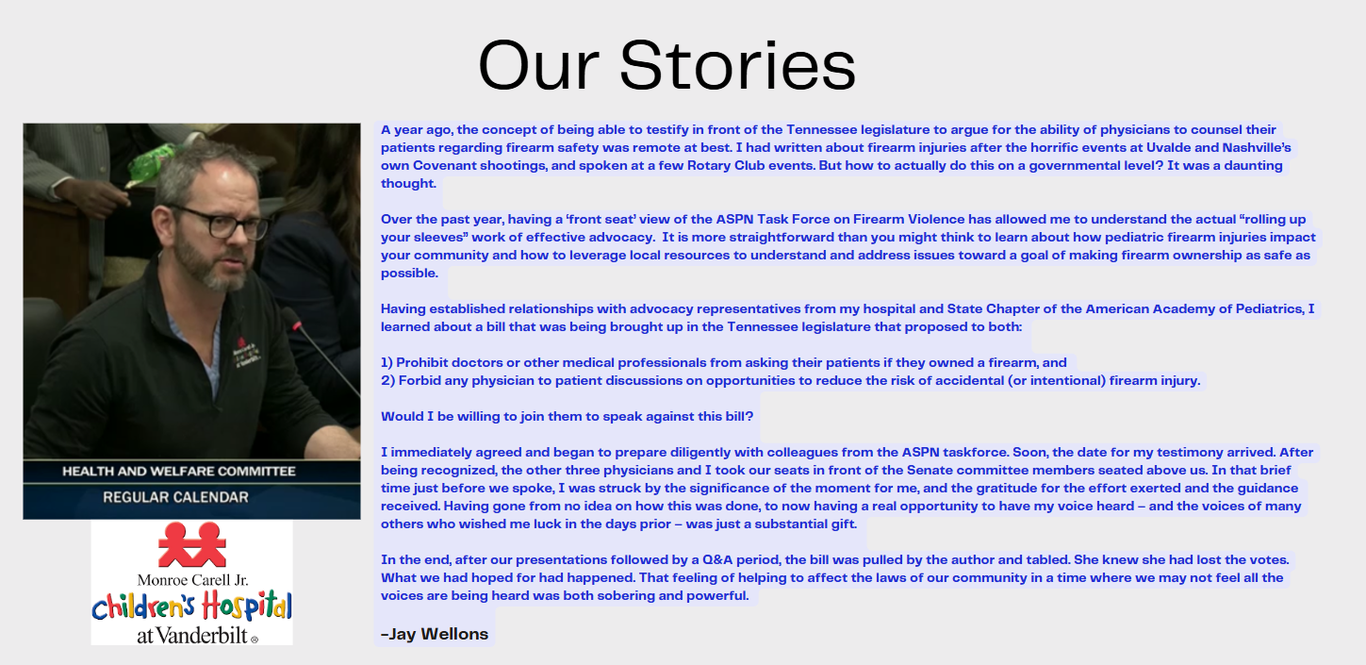
https://tnga.granicus.com/player/clip/31770?view_id=775&redirect=true
Notes:
28:10-30:40

Slide 33
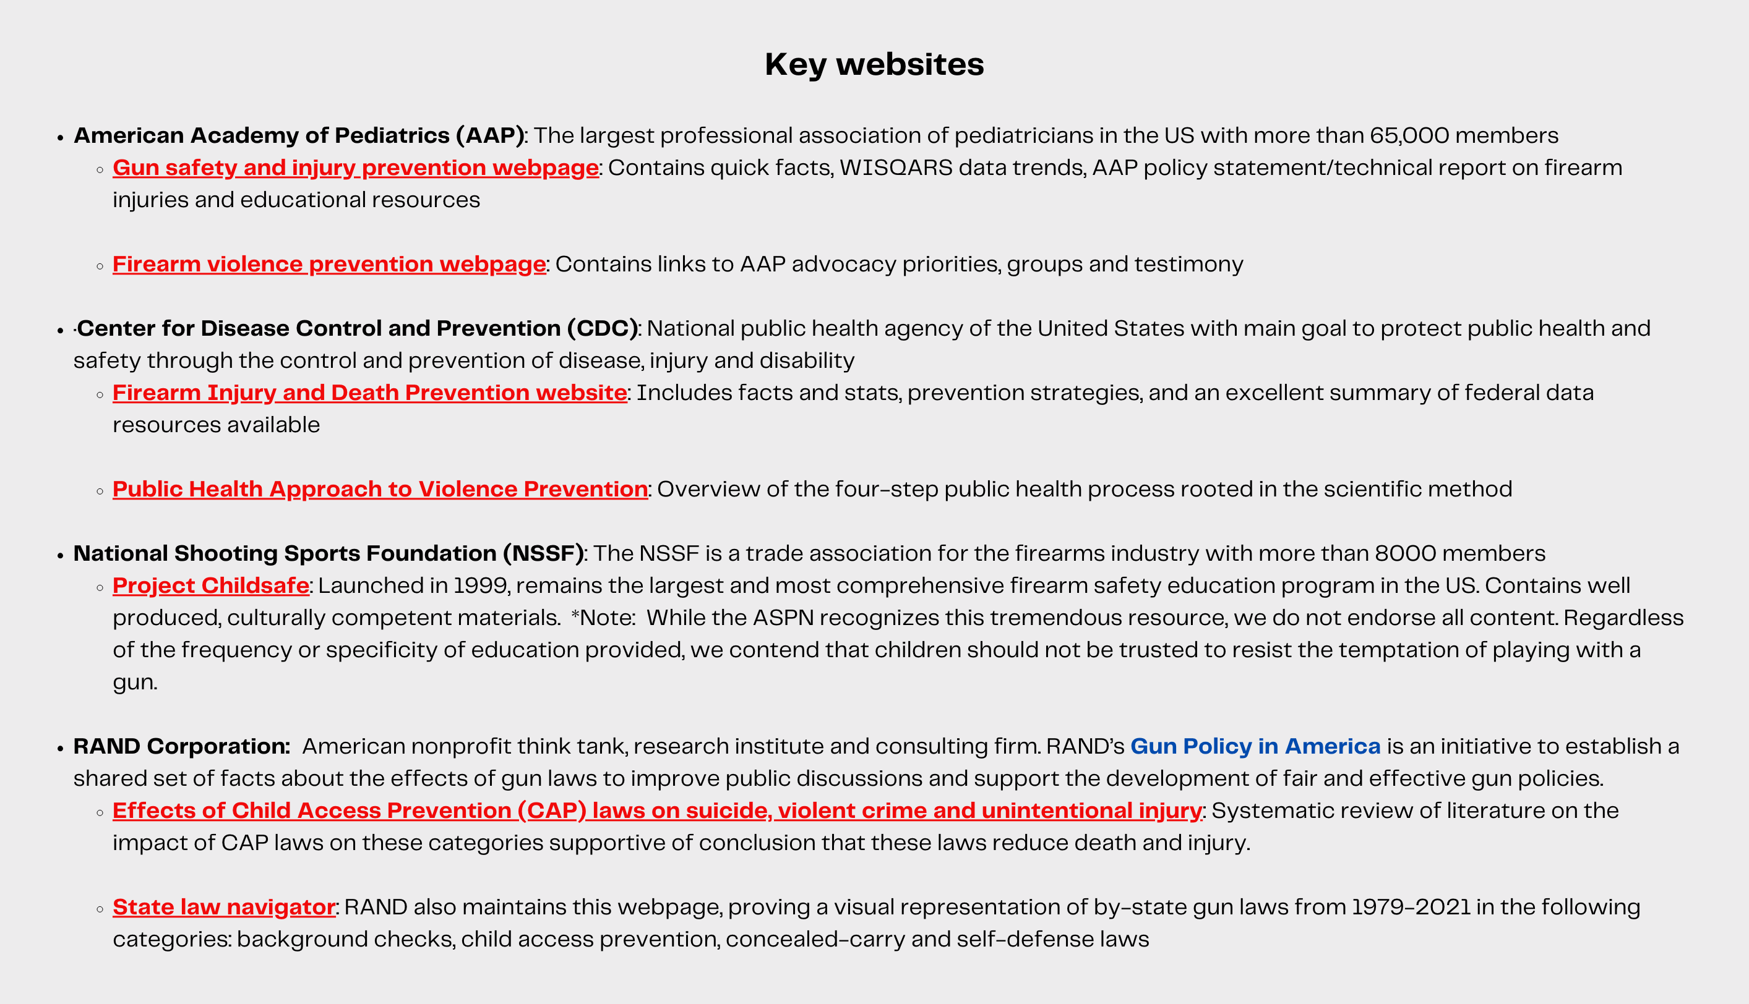
Additional Resources

